Slide 1
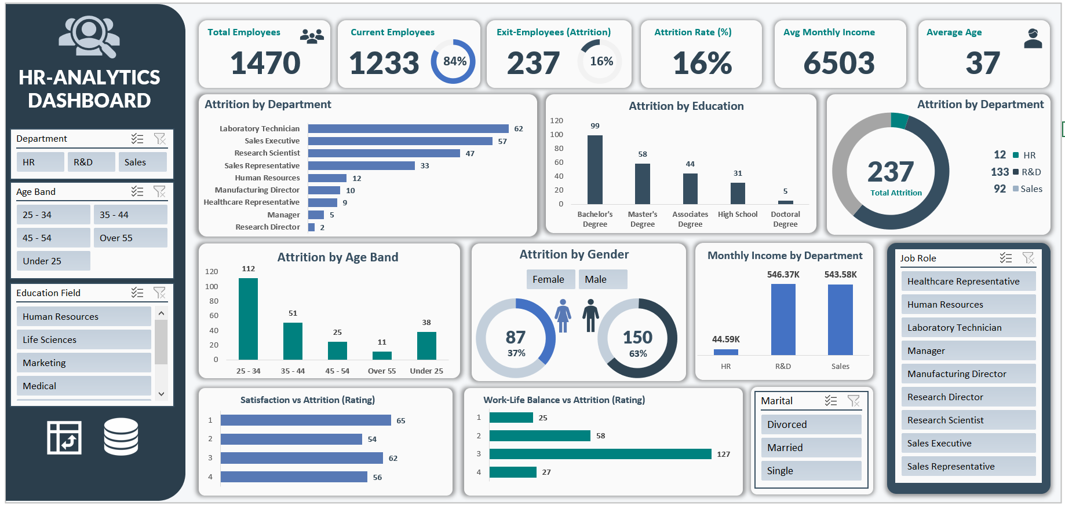

Slide 2
Problem Statement
Business Challenges:
High Employee Attrition The company is facing a significant challenge in retaining employees. It is crucial to track the number of employees leaving the company (attrition) and analyze the attrition rate across departments, job roles, age groups, gender, and education levels.
Department-Wise Workforce Stability Identifying departments with the highest attrition (e.g., Sales Executives, Laboratory Technicians) is essential to address department-specific issues and improve retention strategies.
Demographic Insights Understanding attrition patterns across different demographics such as gender, age band, marital status, and education field is necessary to design employee-centric policies.

Slide 3
Problem Statement
Compensation and Salary Analysis Salary and income play a vital role in employee satisfaction. Monitoring average monthly income by department and linking it with attrition trends helps determine whether low compensation is a factor behind employees leaving.
Employee Engagement & Satisfaction Employee satisfaction indicators like job satisfaction, work-life balance, environment satisfaction, and job involvement directly affect retention. Analyzing attrition against these factors reveals the root causes of dissatisfaction.
Work-Life Balance Issues Employees with poor work-life balance are more likely to quit. Monitoring attrition by work-life balance ratings helps HR take corrective measures to improve employee well-being.

Slide 4
Problem Statement
KPI’s REQUIREMENT
Analyze our HR data to track vital signs of our workforce. By measuring these key metrics, we aim to find answers to important business questions, improve our HR strategies, and make smarter decisions based on evidence.
Total Employees: Total number of employees in the company.
Current Employees: Employees currently working in the company.
Exit Employees: Employees who have left the company.
Attrition Rate: Percentage of employees who left the company.
Avg Monthly Income: Average salary of employees per month.
Avg Age: Average age of employees.

Slide 5
Problem Statement
Attrition by Department & Filter by Department: Identify which departments face the highest employee exits.
Attrition by Job Role & Filter by Gender: Compare attrition across job roles and see if gender impacts it.
Attrition by Age Band & Filter by Age Band: Analyze which age groups are leaving more.
Attrition by Gender & Filter by Education Field: Check if gender and education field affect employee attrition.
Attrition by Education & Filters (All): Explore how education field links to employee exits with applied filters.

Slide 6
Problem Statement
· Satisfaction vs Attrition (Job Role filter): Find how job satisfaction impacts employee exits across different roles.
· Work-Life Balance vs Attrition (Marital Status filter): Analyze if work-life balance ratings affect attrition by marital status.
· Monthly Income Distribution by Department (Job Role filter): Compare income patterns across departments to check their link with attrition.

